Slide 1

Gym Management System: A Data-Driven Approach
This presentation outlines the development of a comprehensive Gym Management System, leveraging a suite of data tools to streamline operations and enhance insights. We'll explore its architecture, implementation, and the valuable analytics it provides.
Name : Alhassan Ahmed

Slide 2



Project Overview: Building a Smart Gym
Our project's core purpose is to efficiently manage gym operations, from member registration and class scheduling to payment tracking and attendance. We utilized a robust technology stack including SQL Server for data storage, Python (Pandas) for data manipulation, Excel for preliminary reporting, and Power BI for interactive dashboards.
Data Management
Insight Generation
Intuitive Reporting
Structured storage for members, trainers, classes, and financial transactions.
Transforming raw data into actionable business intelligence.
Delivering clear, interactive visual summaries for stakeholders.

Slide 3
Database Design: The Blueprint
The foundation of our system is a well-structured relational database. Our Entity-Relationship Diagram (ERD) illustrates the interconnectedness of key entities: Members, Trainers, Classes, Attendance, and Payments. This design ensures data integrity and efficient retrieval.

Slide 4
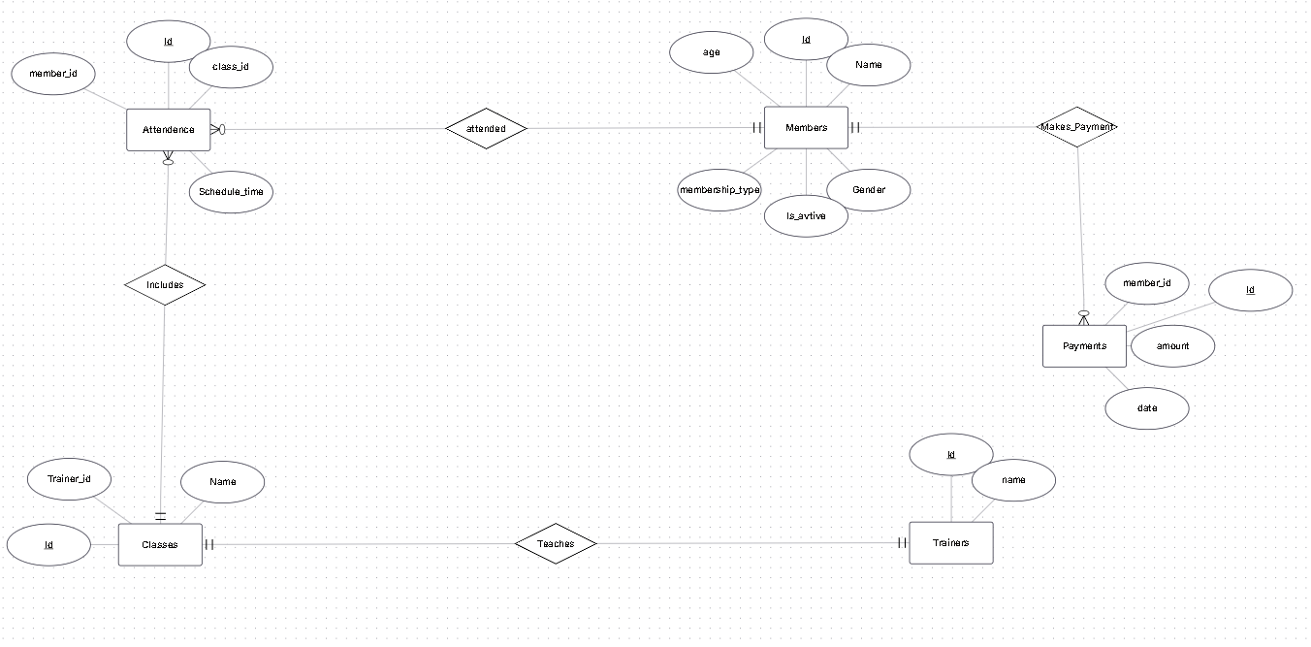

Slide 5
Database Implementation: Bringing the Design to Life
We translated our ERD into a functional database with five distinct tables, carefully defining Primary Keys for unique identification and Foreign Keys to establish crucial relationships between entities. Sample data was then inserted to populate the database for testing and analysis.
Table Creation
Data Population
Designed and built 5 interconnected tables to house all gym data.
Manually inserted comprehensive sample data for testing and demonstration purposes.
1
2
3
Key Definition
Implemented Primary and Foreign Keys to enforce data integrity and relationships.

Slide 6
Sample Data: A Snapshot
To illustrate the data structure, here's a glimpse into the Members and Payments tables. This sample data is crucial for validating our database design and for performing the subsequent analytical queries.
Members Table Snippet
Payments Table Snippet
MemberID
Name
MembershipType
JoinDate
PaymentID
MemberID
Amount
PaymentDate
101
Alice Smith
Premium
2023-01-15
P001
101
75.00
2023-01-15
102
Bob Johnson
Standard
2023-02-01
P002
102
50.00
2023-02-01
103
Carol White
Premium
2023-03-10
P003
101
75.00
2023-02-15

Slide 7
SQL Business Queries: Unlocking Insights
We developed 10 meaningful SQL queries to extract critical business insights from our database. These queries provide a deep understanding of gym performance, member demographics, and operational efficiency, guiding strategic decisions.
Monthly Revenue
Top 5 Trainers by Attendance
Active vs. Inactive Members
Attendance by Weekday
Membership Type Distribution
Most Popular Classes
Average Age by Membership
Average Payment per Member
Gender Distribution
Revenue by Membership Type

Slide 8
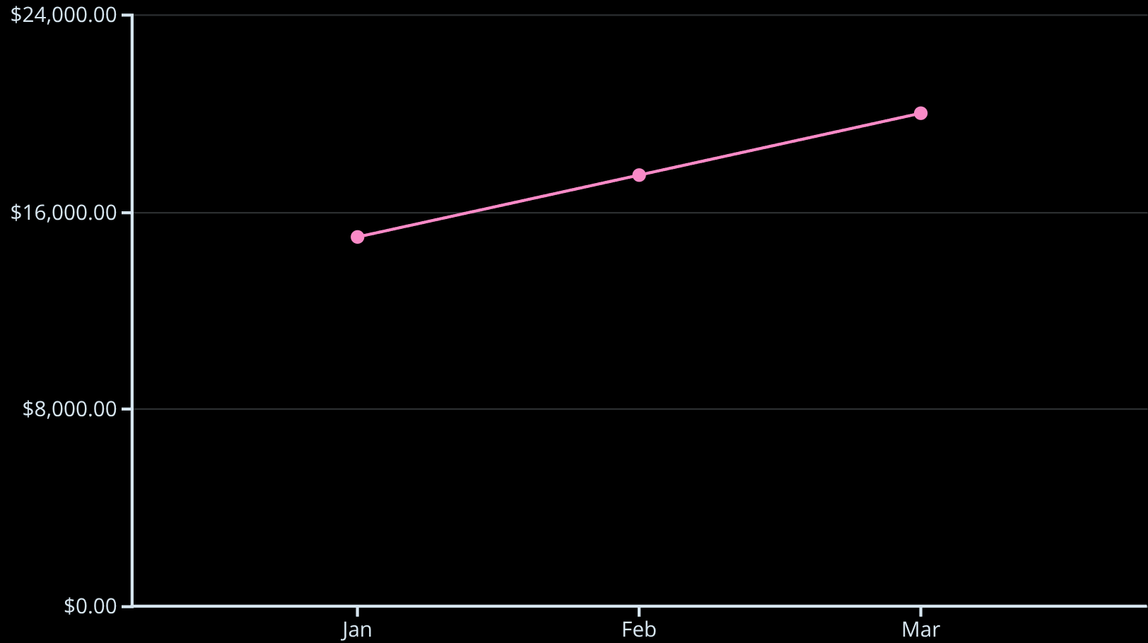
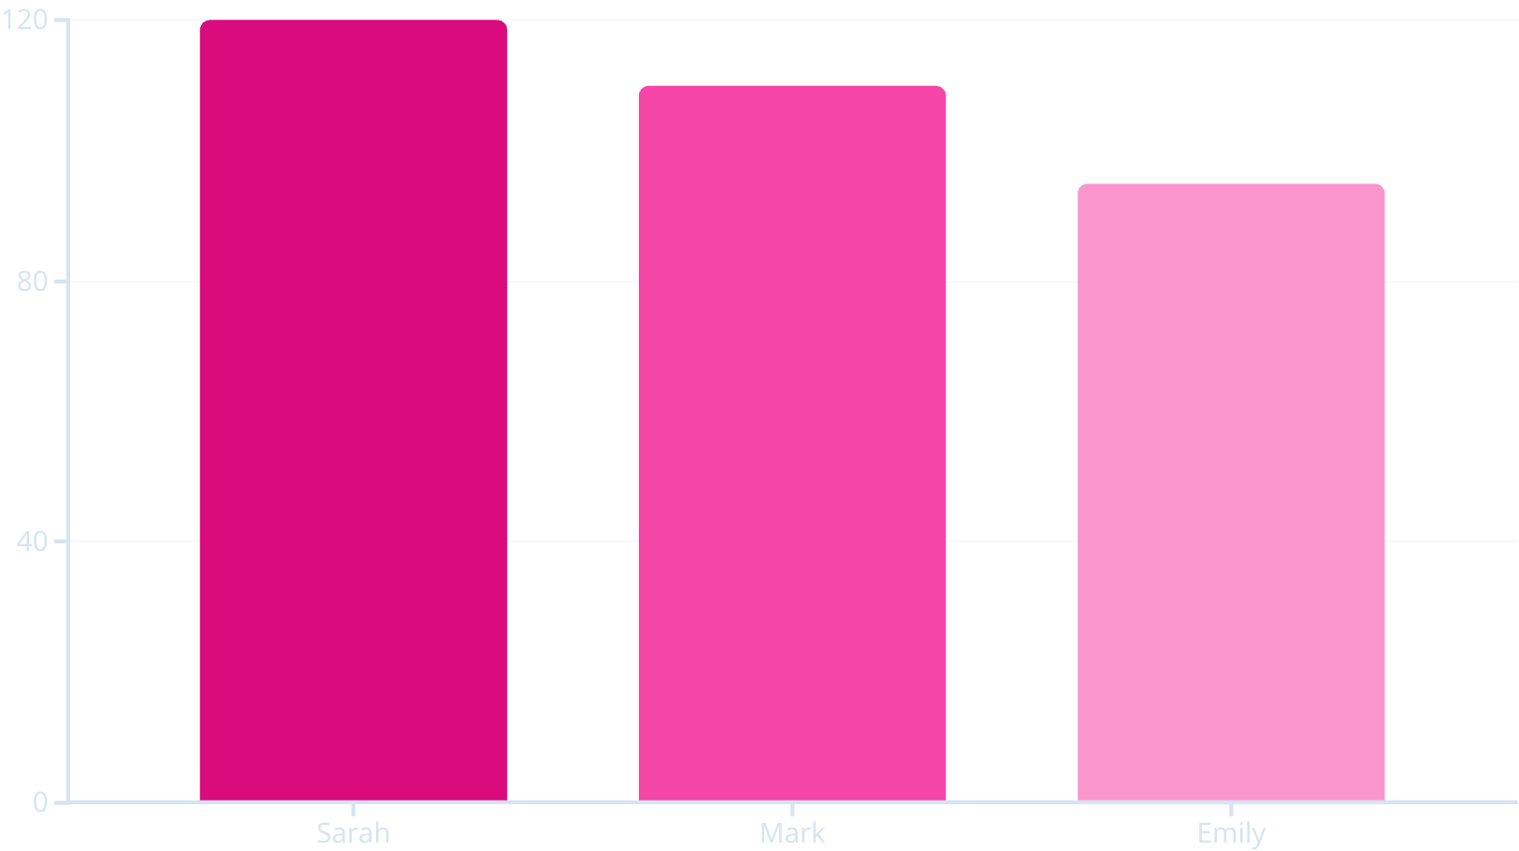
Query Results: Visualizing Performance
Beyond raw data, we transformed query results into intuitive charts. These visualizations highlight key trends, such as Revenue Trend, the Top Trainers driving attendance, and the Most Popular Classes, enabling quick comprehension of gym performance.
Monthly Revenue Trend
Top Trainers by Attendance

Slide 9
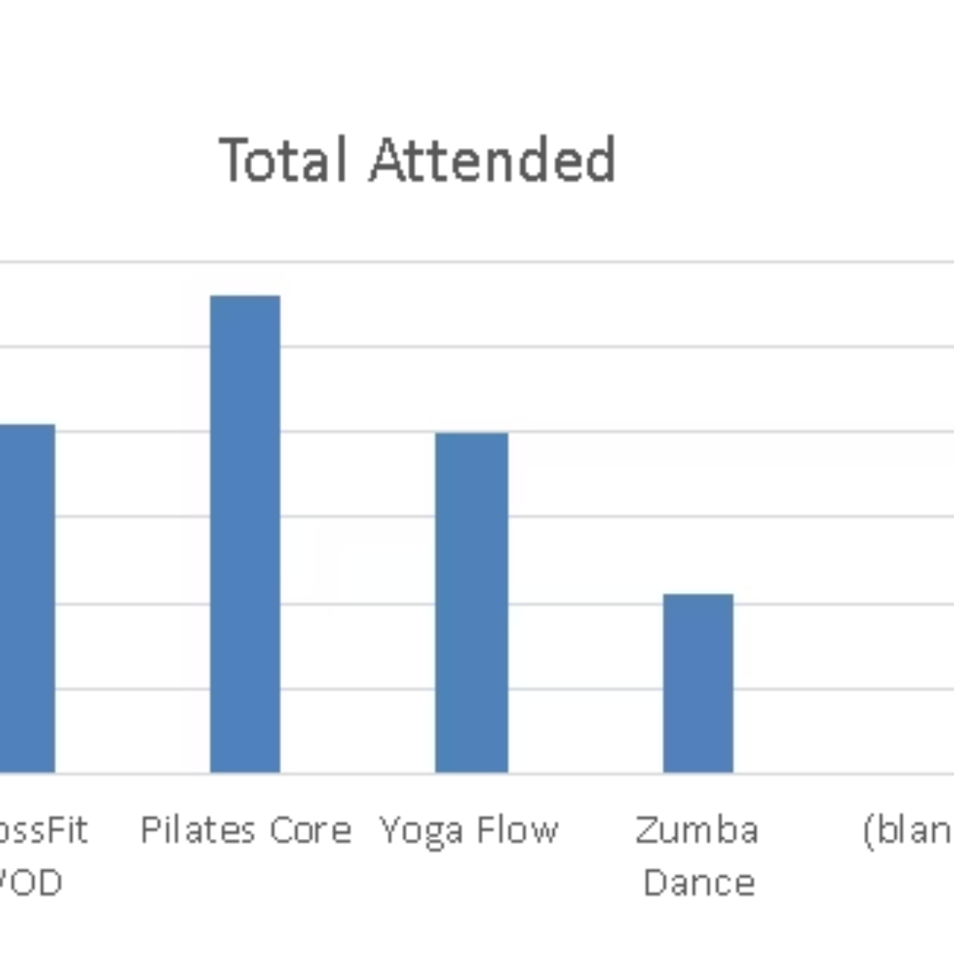
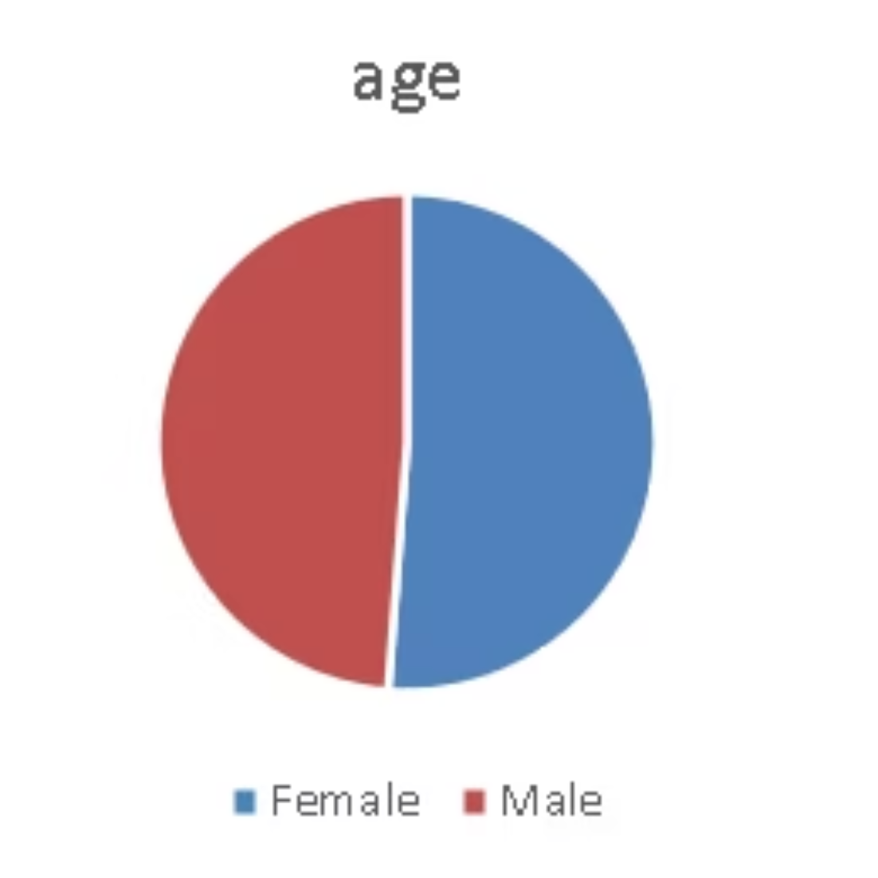
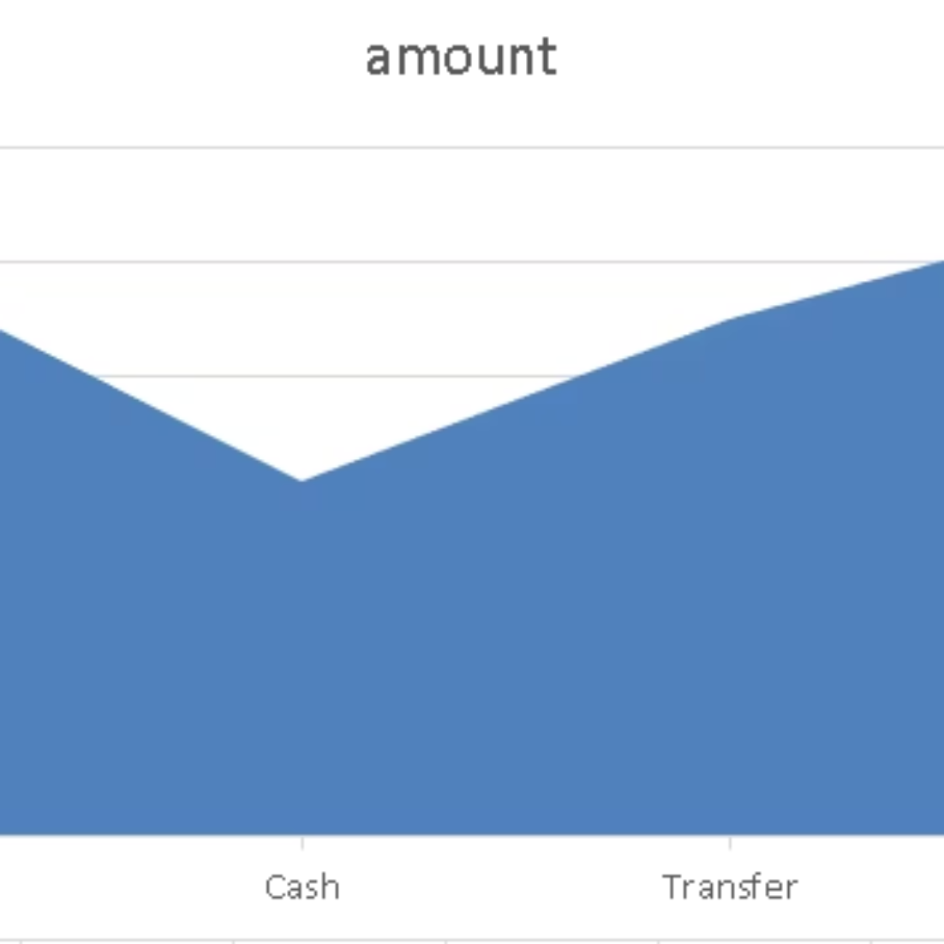
Excel Reports: Deeper Dive with Familiar Tools
Leveraging Excel, we exported query results for further analysis and reporting. Pivot Tables provided dynamic summarization of data, while Charts offered accessible visual representations of trends in revenue, membership demographics, and gender distribution.

Slide 10
Power BI Dashboard: Interactive Insights at a Glance
Our interactive Power BI dashboard provides a holistic view of gym performance. Key Performance Indicators (KPIs) like Total Revenue, Active Members, and Most Popular Classes are prominently displayed. Users can interact with charts and filters to explore data in real-time.

Slide 11
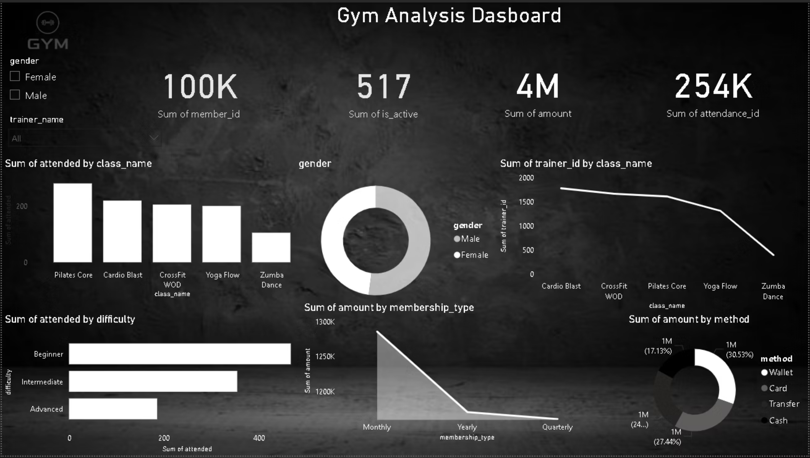

Slide 12
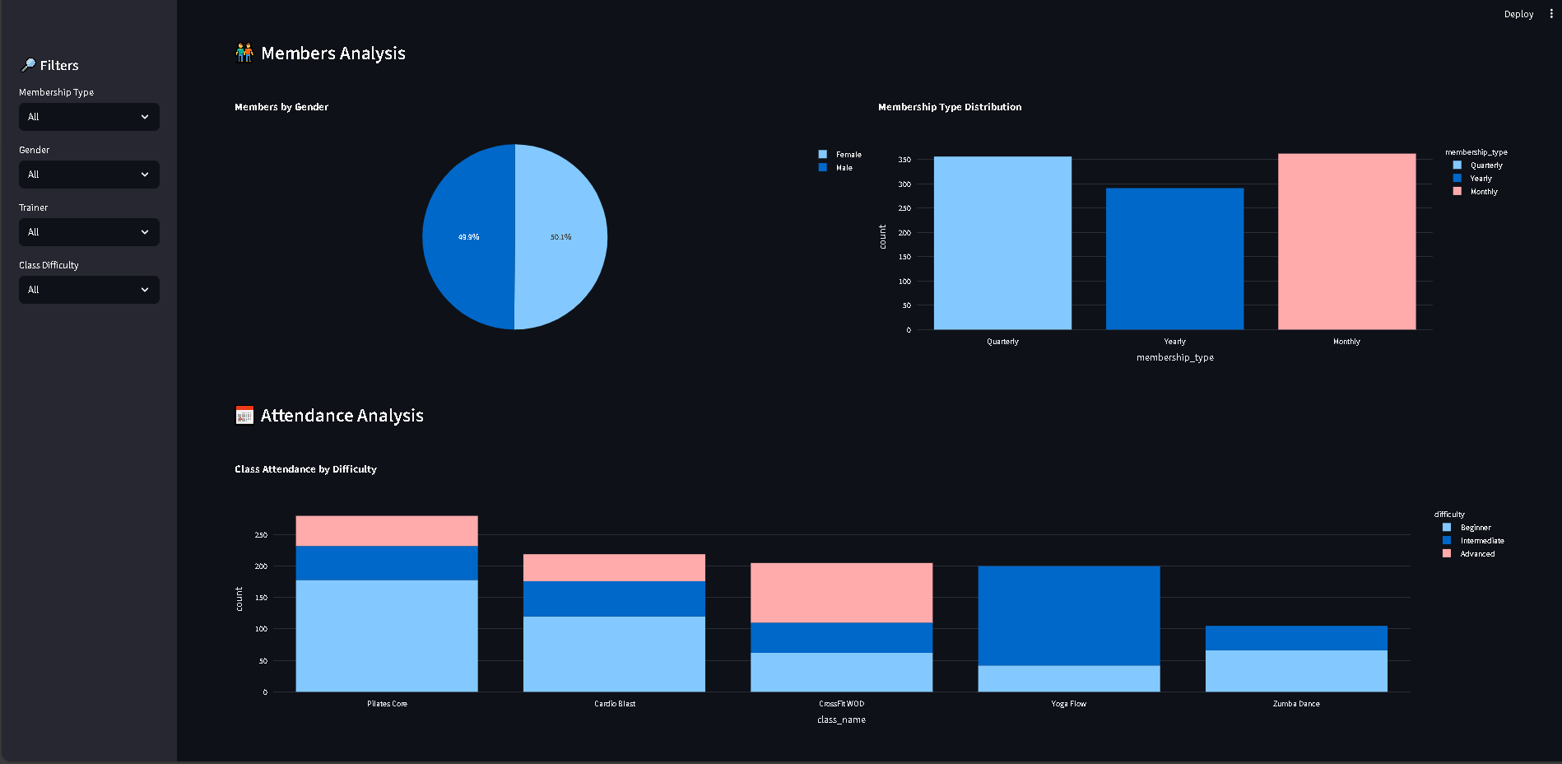
Streamlit Dashboard

Slide 13
Conclusion: A Complete Data Solution
This project provided invaluable experience in SQL, data cleaning, and visualization, culminating in an end-to-end gym management data system. The skills acquired are directly applicable to real-world data challenges.
Key Learnings
Project Outcome
Future Scope
SQL Proficiency
Functional Data System
Machine Learning
Data Transformation
Actionable Business Insights
Predictive Analytics (e.g., Churn)
Effective Visualization
Foundation for Growth
Automated Reporting

